Slide 1
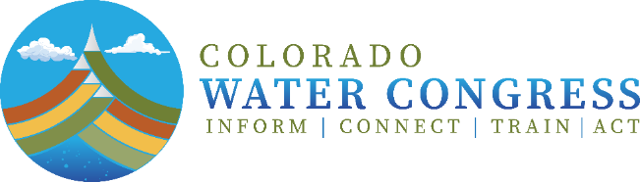
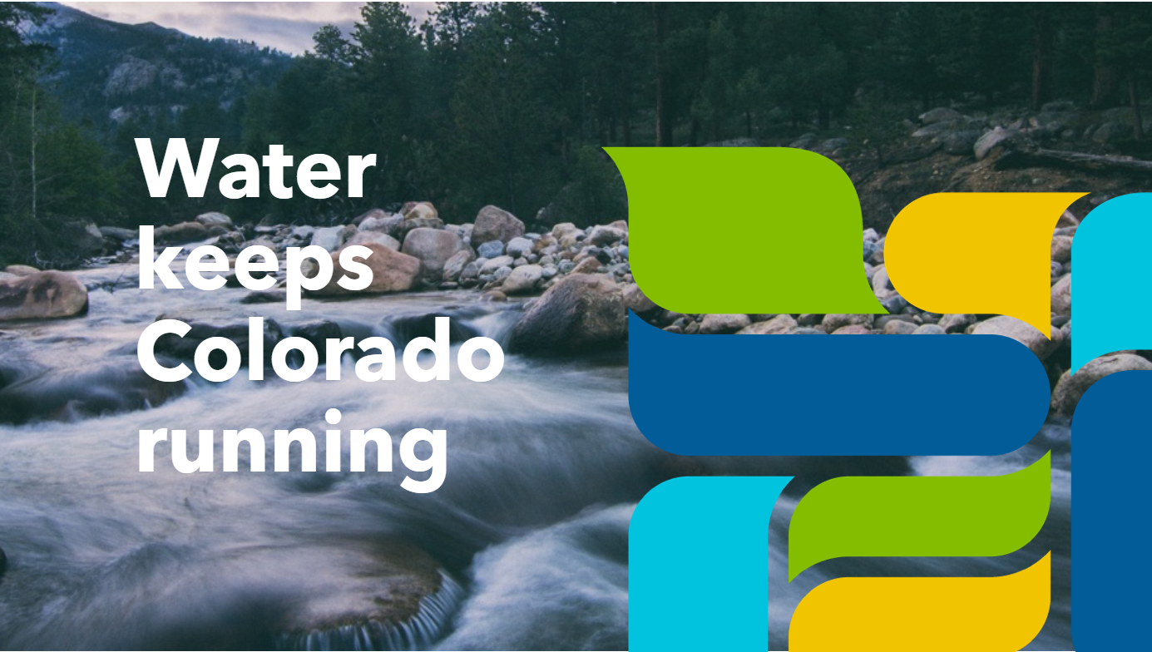

Legislative Water Workshop “201”
Current Events Concerning
Interstate Compacts
April 3, 2024

Slide 2
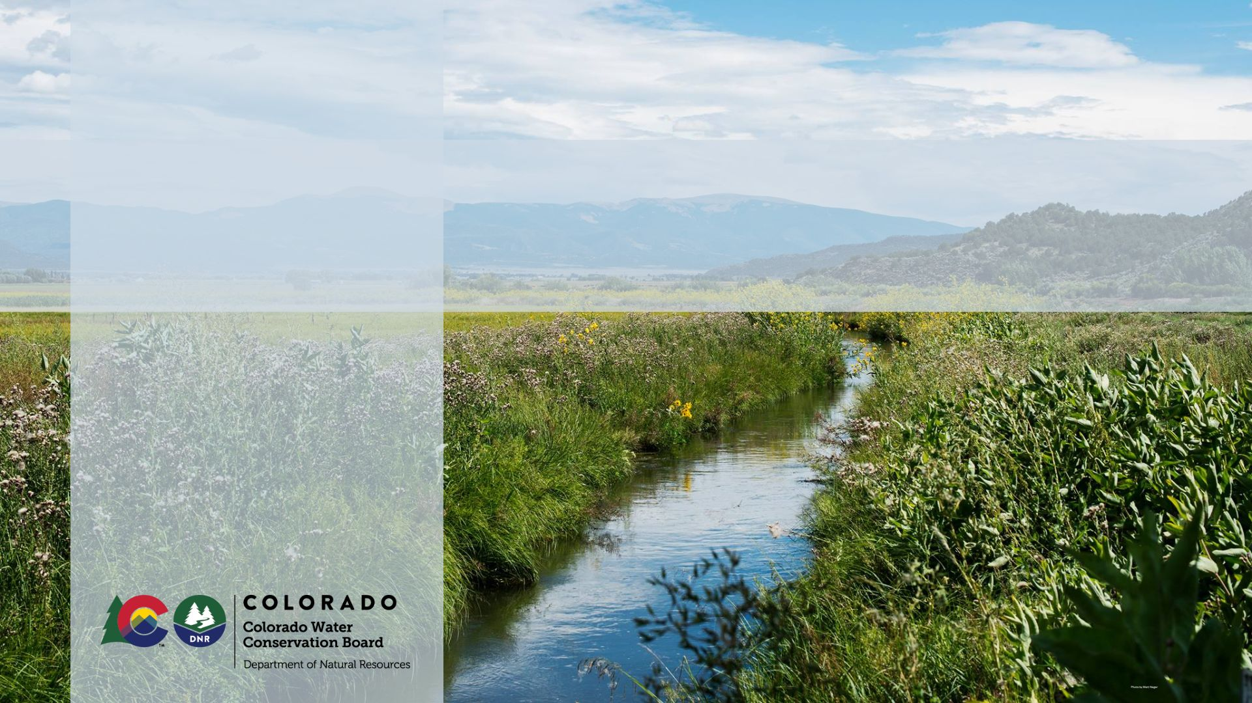
Colorado River
Updates from the Commissioner
Becky Mitchell
Colorado River Commissioner
State of Colorado

Slide 3



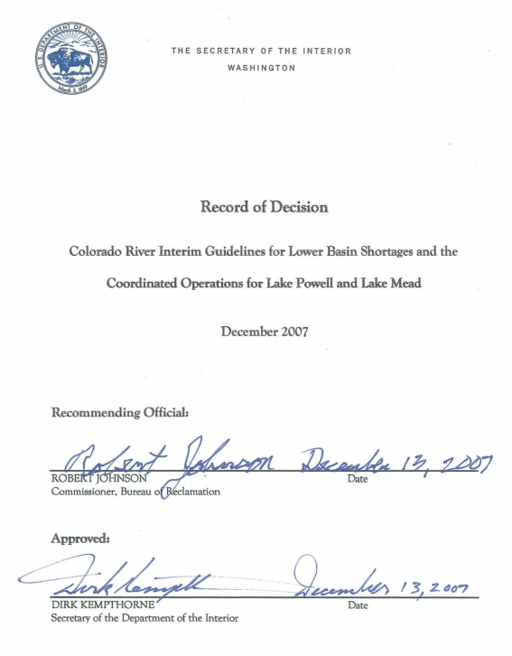

March 11
Reclamation deadline to submit modeling proposals
March 6
Upper Division States submit Alternative for Reclamation to model
March 2024 and beyond
Discussions continue
The ‘07 Interim Guidelines expire in 2026
Notes:
Why we are where we are.

Slide 4
Upper Division States Alternative
The Upper Division States Alternative provides
an approach for Post-2026 operations of Lakes Powell and Mead that is designed to respond to hydrologic conditions, help rebuild storage, protect water users and resources, and operate within the Law of the River.
Notes:
Why we are where we are.

Slide 5
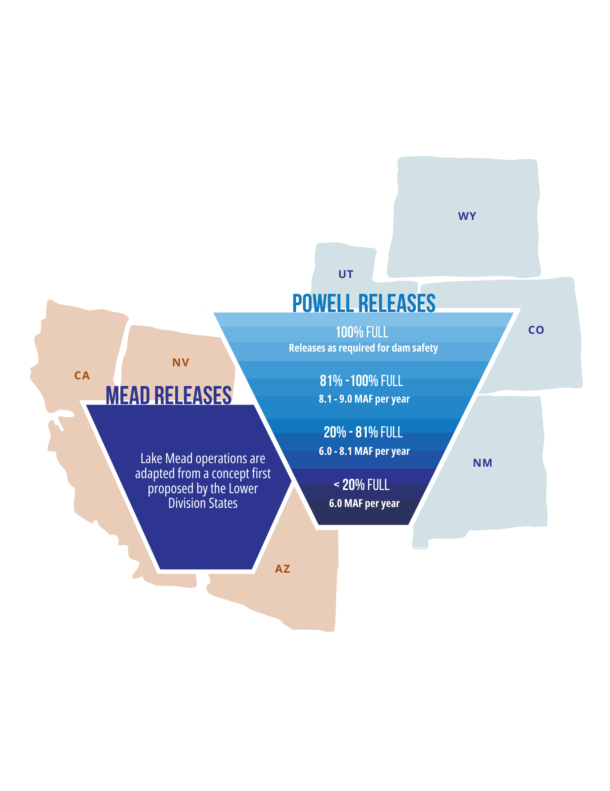
UDS Alternative
Post-2026 Operations
Of Lake Powell & Lake Mead
Colorado, New Mexico,
Utah, and Wyoming
submitted the “UDS
Alternative” on March 6.
It provides for sustainable
operations that are aligned
with hydrologic conditions and
is designed to help rebuild storage.
It operates within the Law of the River.
Notes:
Why we are where we are.

Slide 6
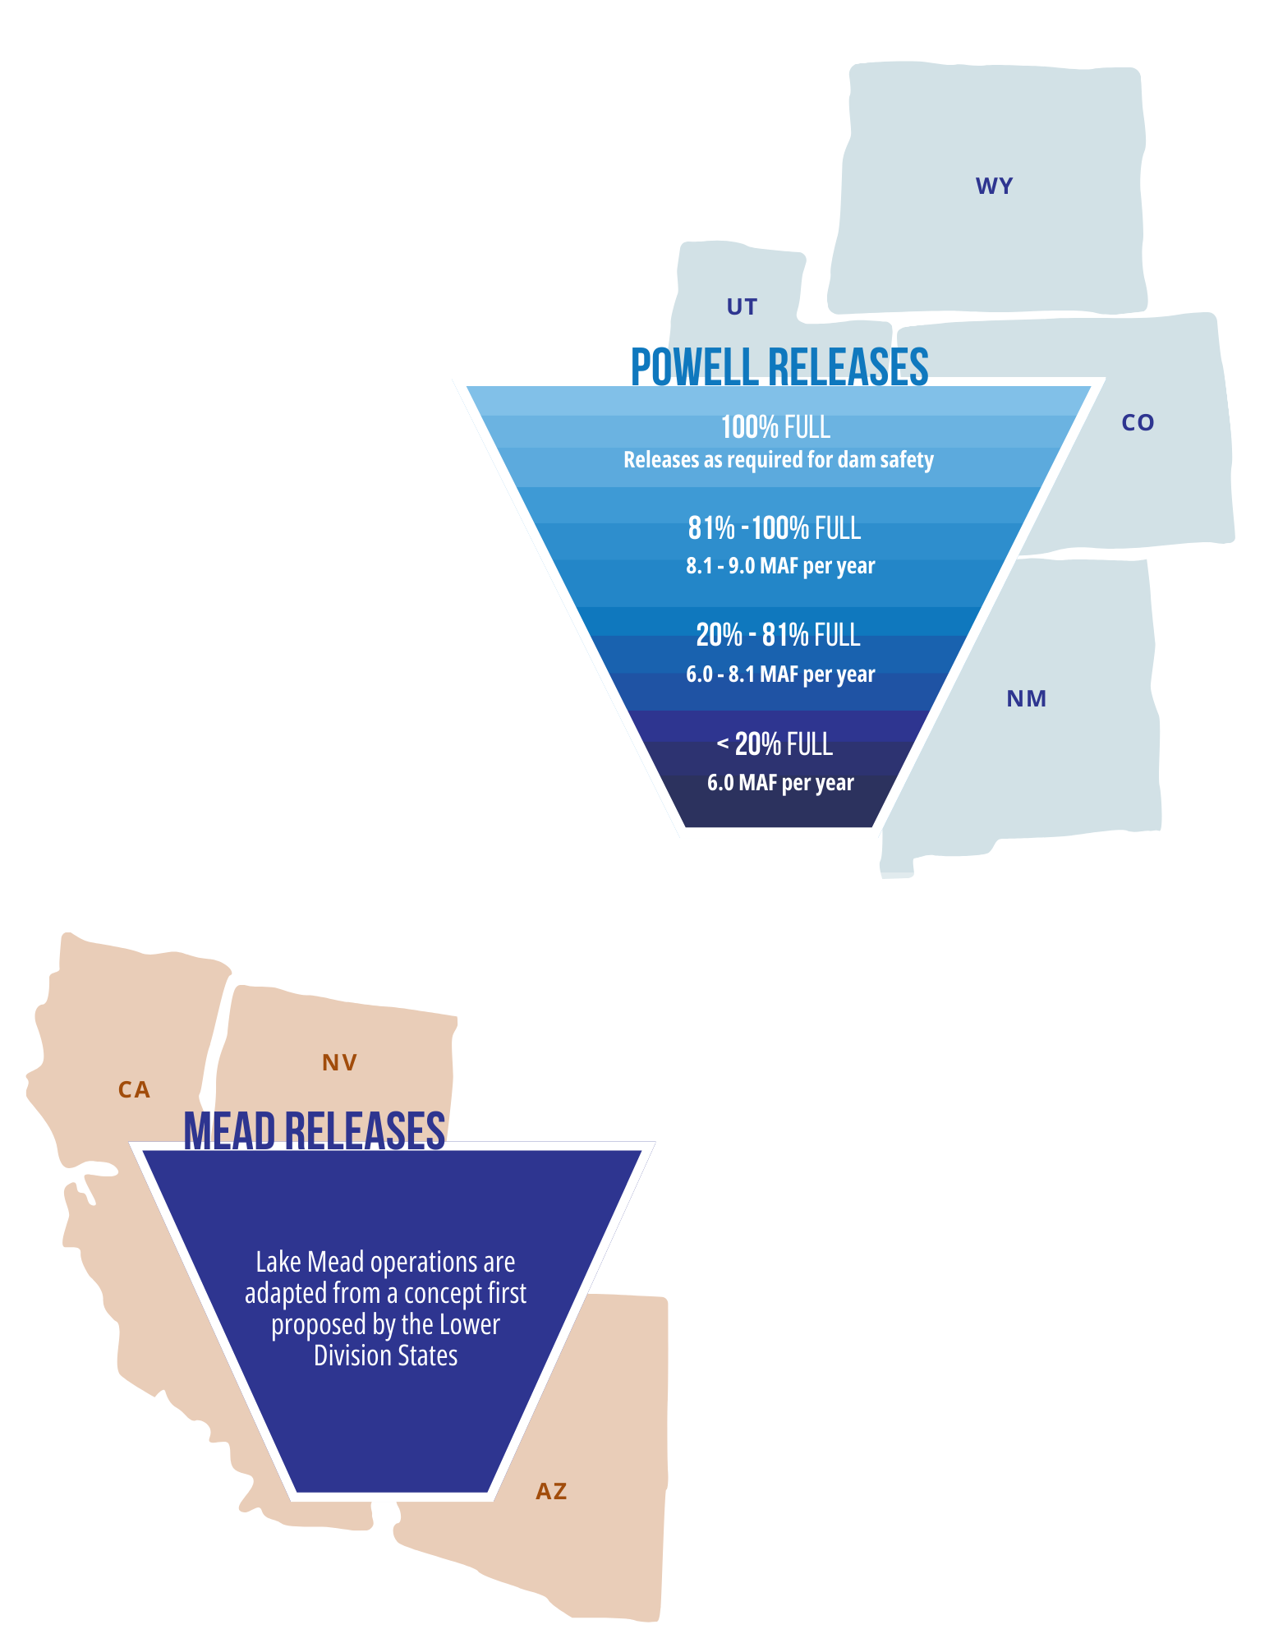
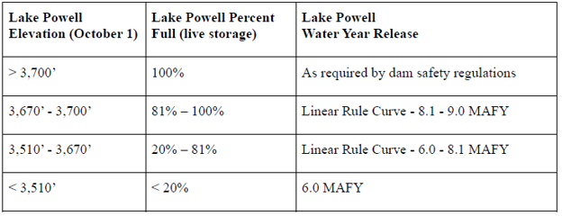
UDS Alternative
Powell Operations
Lake Powell operations designed to be responsive to hydrologic conditions and help rebuild storage.
Lake Powell release is determined by a continuous and linear rule curve based on storage level on October 1.
Avoids sharp deviations and discontinuities between tiers.
No balancing releases.
Lake Powell level used as a proxy for hydrologic conditions.
Notes:
Why we are where we are.

Slide 7

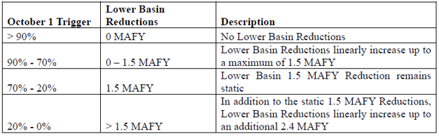
UDS Alternative
Mead Operations
Lower Basin reductions are based on combined storage
of Lake Powell and Lake Mead.
Storage amounts are used to determine a Trigger on October 1 that sets operations.
Trigger is a percentage of current live storage of the two reservoirs with a threshold volume of 8.7 million acre-feet (combined) removed.
Notes:
Why we are where we are.

Slide 8
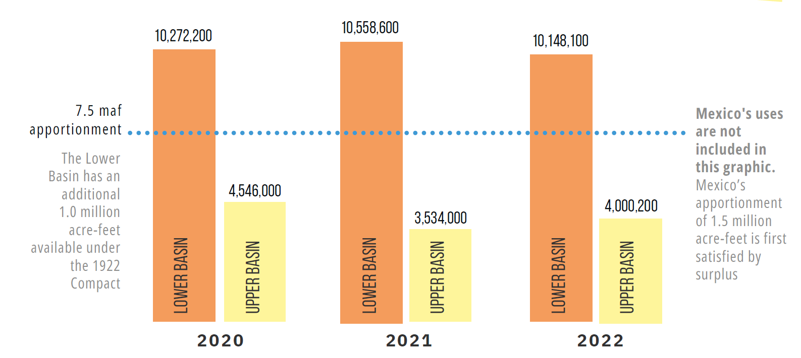
Hydrologic Shortage

Slide 9
UDS Alternative
Parallel Activities
The Parallel Activities section acknowledges that there may be
activities outside the scope of the Post-2026 Operations framework
that may complement the Post-2026 Alternative.
Parallel Activities may be pursued if the UDS Alternative is adopted.
Parallel Activities may include:
  Voluntary conservation
  Potential releases and recovery at CRSPA Initial Units (Blue Mesa,
  Flaming Gorge, Navajo)
Any such Parallel Activities would be subject to new agreements outside the
scope of the Post-2026 process and should be used to protect Lake Powell’s
continued ability to make releases and to protect Upper Basin interests.
The UDS Alternative also acknowledges undeveloped settled Tribal water rights.

Slide 10
Continued Collaboration
All Upper Division States remain committed to
working with the Lower Basin States to develop
a consensus alternative.
The Upper Division States are committed to continued collaboration with the Bureau of Reclamation, Basin States, Tribal Nations, water users, and environmental and recreational groups.

Slide 11

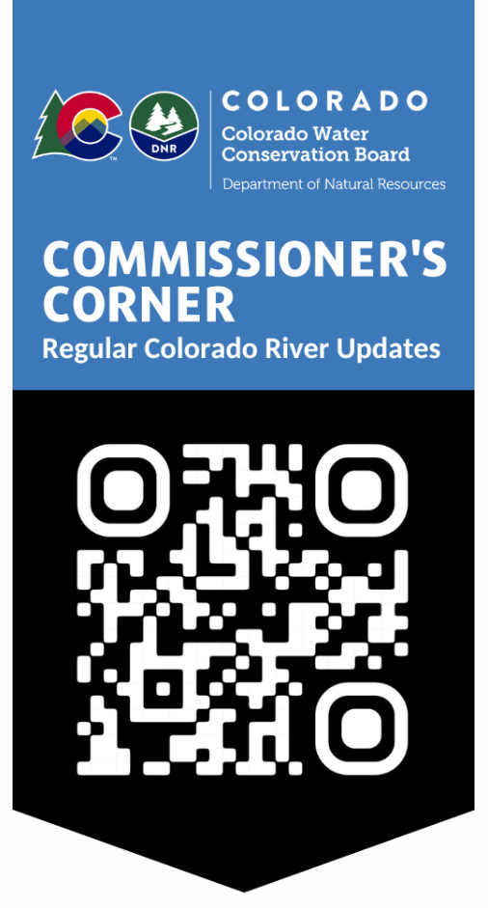
Stay Informed
Commissioner’s Corner
State staff
  DNR_ColoradoRiver@state.co.us
  Amy.Ostdiek@state.co.us

Slide 12
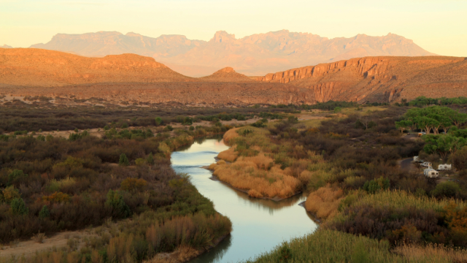
Rio Grande Compact
Texas v. New Mexico and Colorado,
No. 141, Original

Slide 13

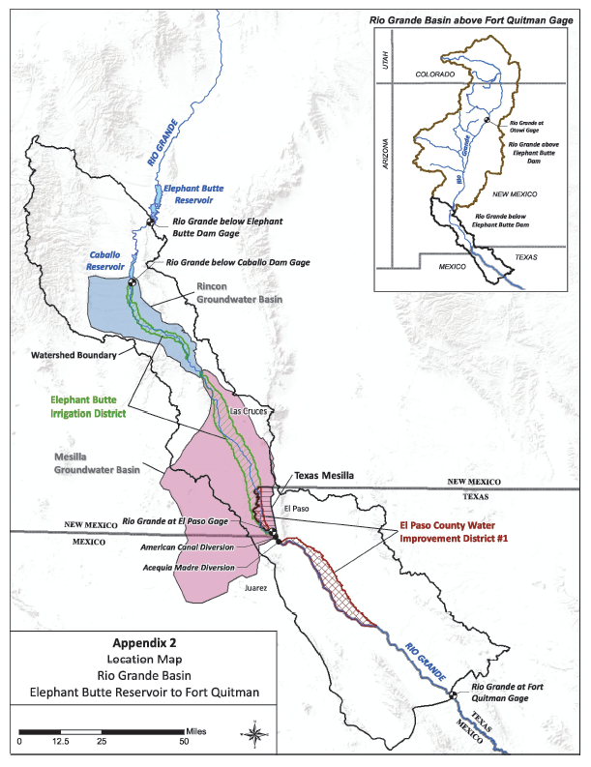

Slide 14
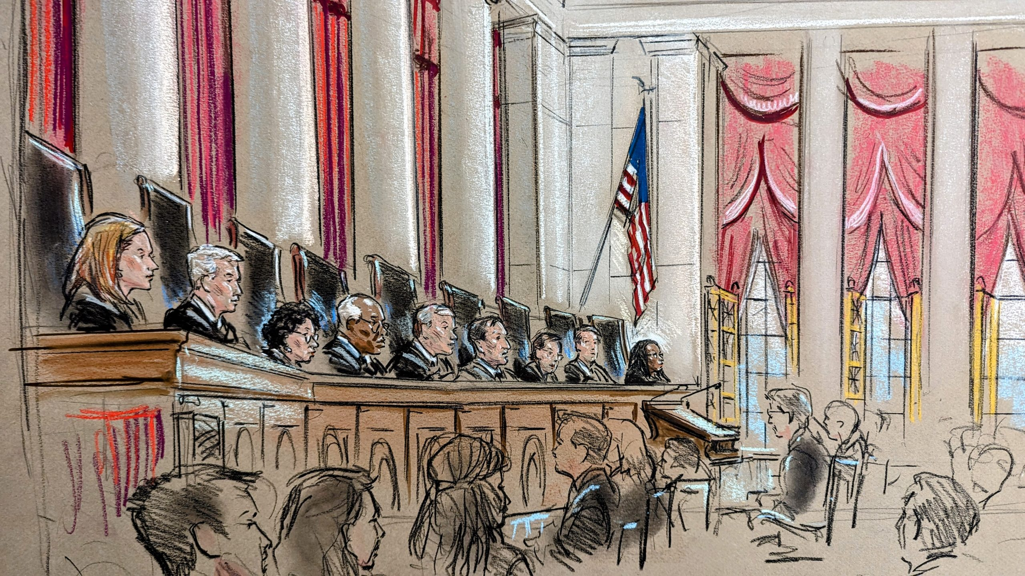

Slide 15
Questions?

Slide 16
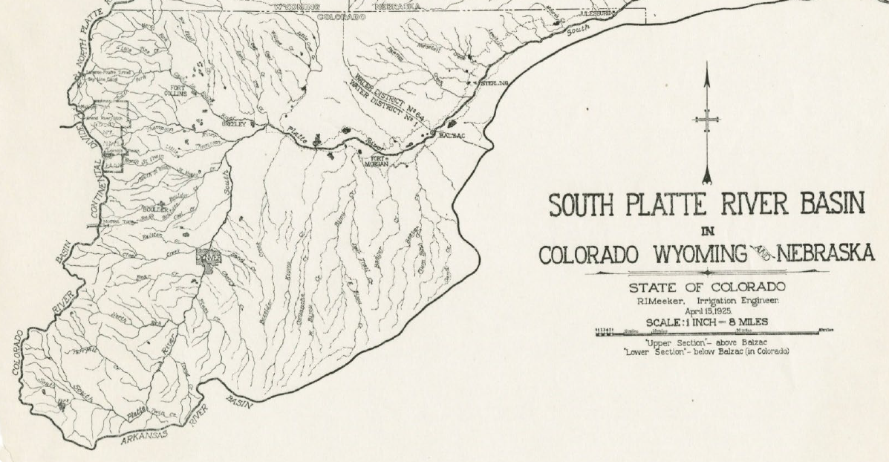
South Platte Compact
Jim Yahn
Tracy Kosloff
Notes:
Jim
Tracy

Slide 17

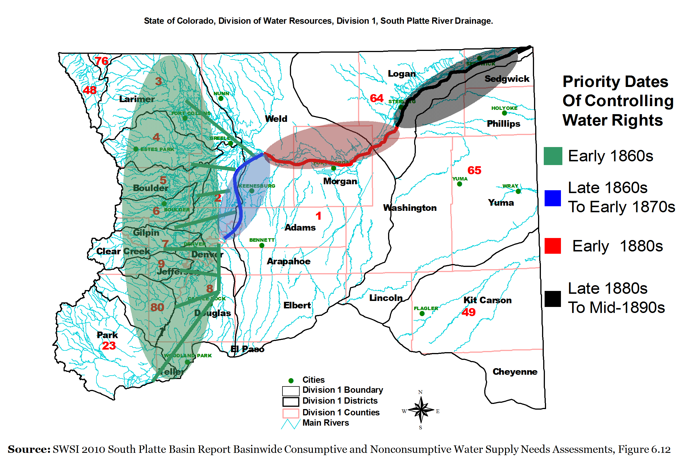
Return Flows
Cause Water Rights Development Downstream
Notes:
Jim

Slide 18
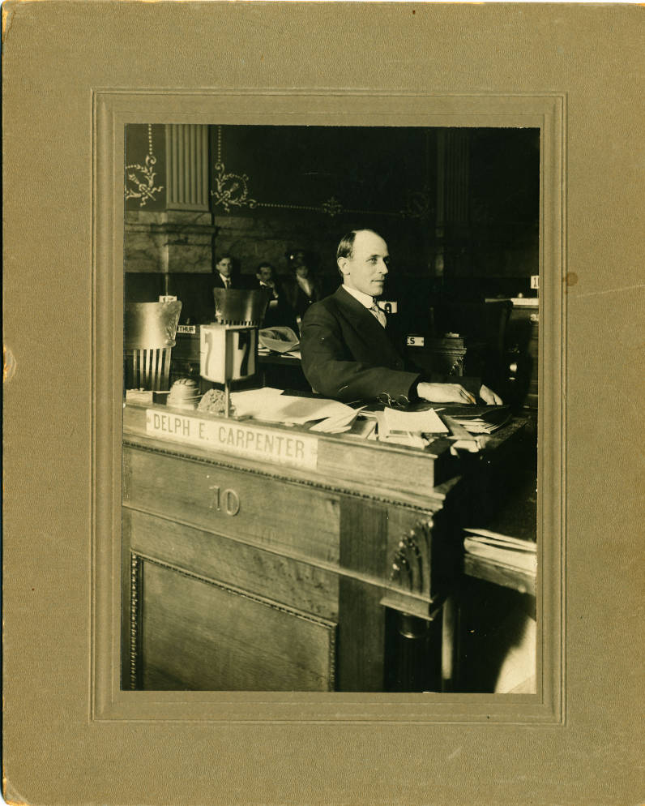
Lawsuit then Compact
1916 – Nebraska irrigators sue Colorado
Studies of the South Platte in Colorado
  Return flows = steady flow at state line
  Lower Section – unlikely further irrigation or reservoir development
1923 – Compact Signed
Notes:
Tracy

Slide 19
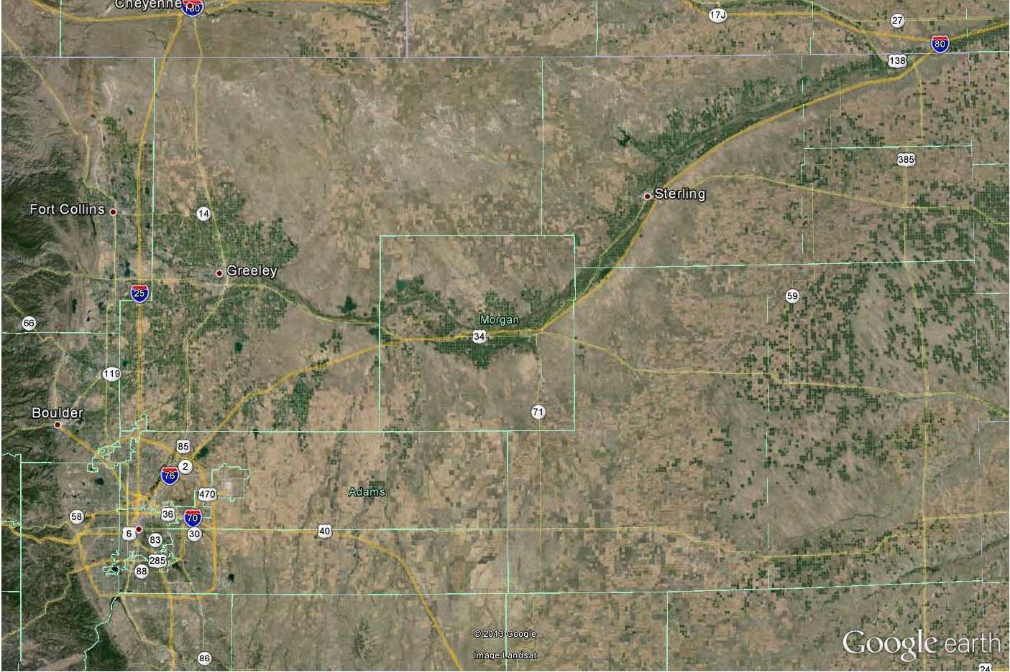
Upper Section
- Morgan County and Upstream
- Water District 1
Lower Section
- Washington County
- Water District 64
Upper Section
Lower Section
Notes:
Tracy

Slide 20
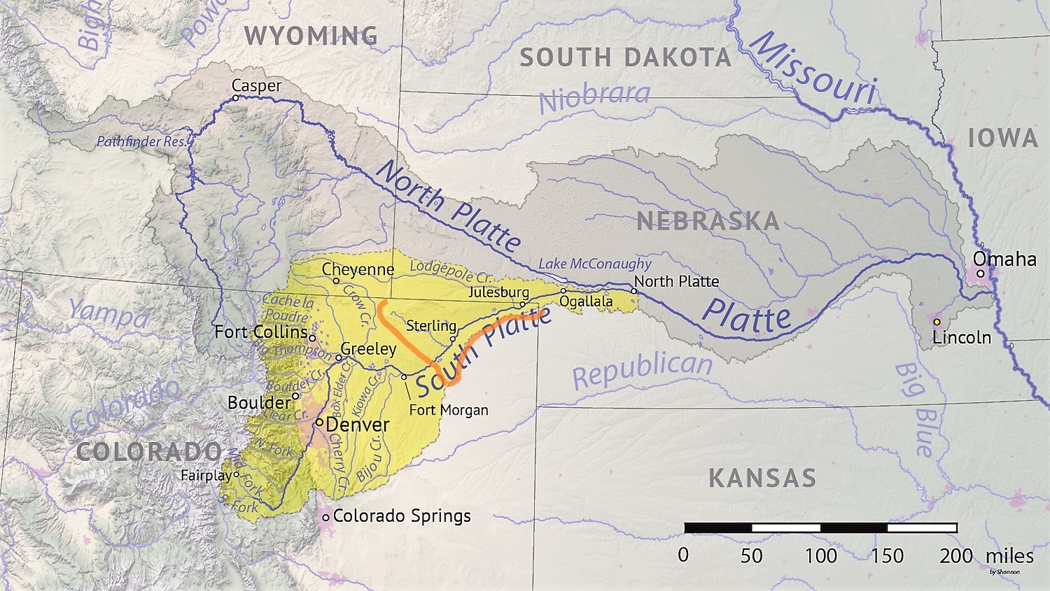
Compact Summary
Summer (April 1 – Oct. 15)
  If flow at interstate station <120 c.f.s., then curtail rights in District 64 junior to 1897
Winter (Oct. 15 – April 1)
  CO has full and uninterrupted use (except art. VI)
  NE: Perkins County Canal – 500 cfs with 1921 Priority against lower section rights
  CO: Prior right to store 35,000 acre-feet
Notes:
Jim

Slide 21
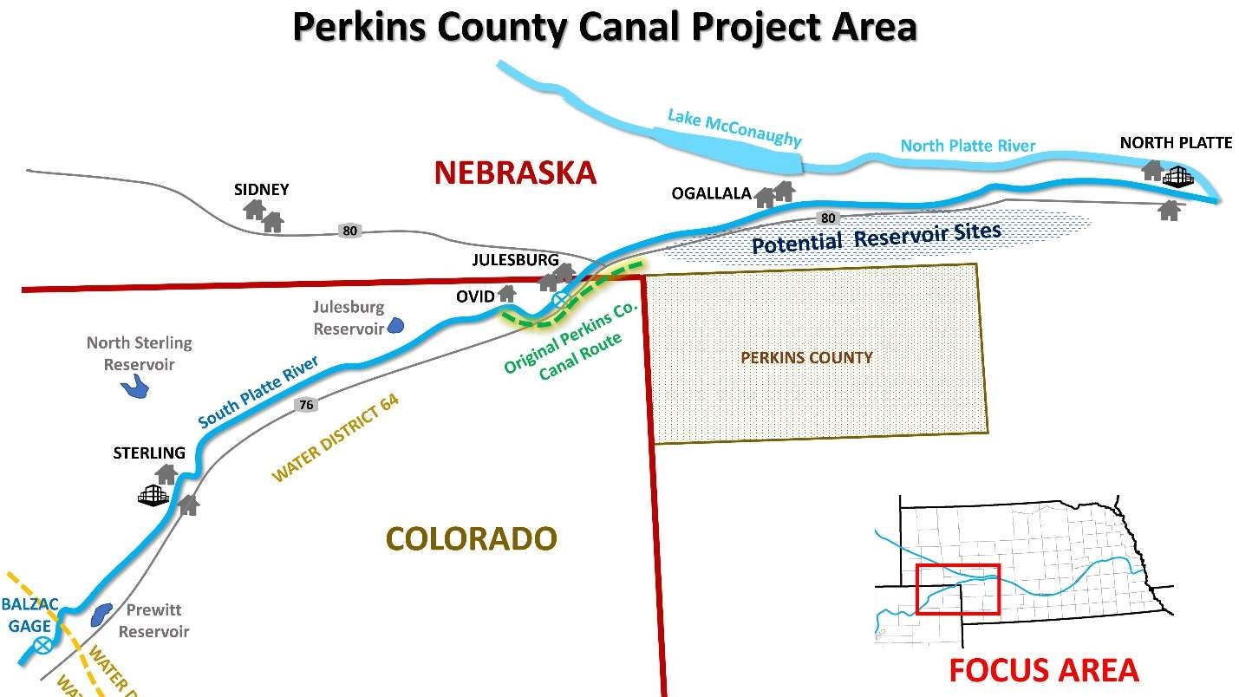
Notes:
Jim

Slide 22
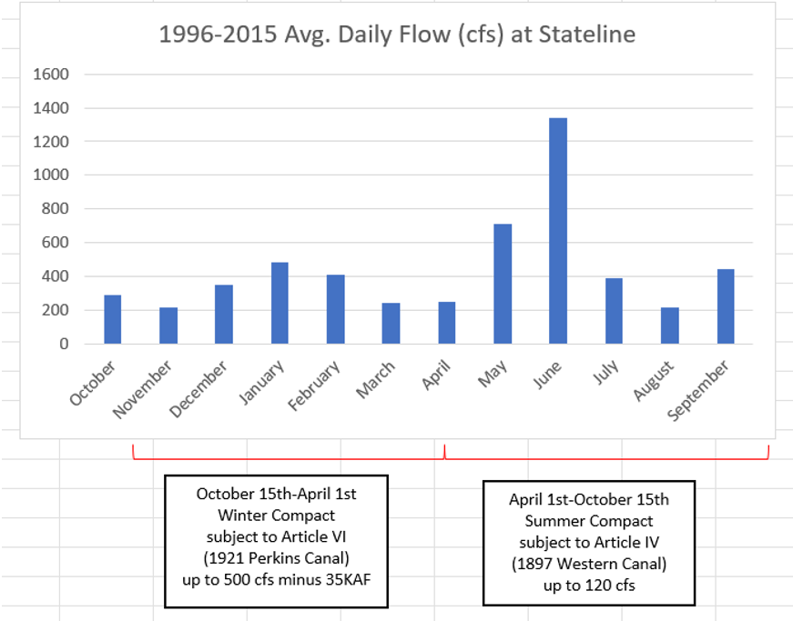
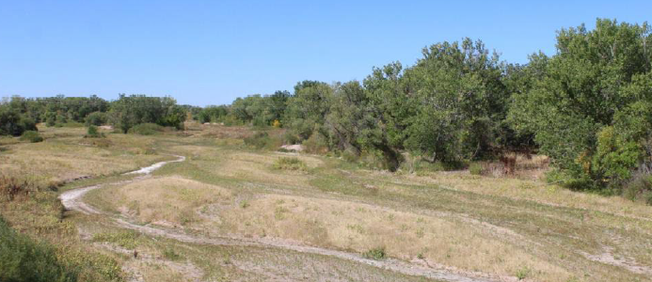
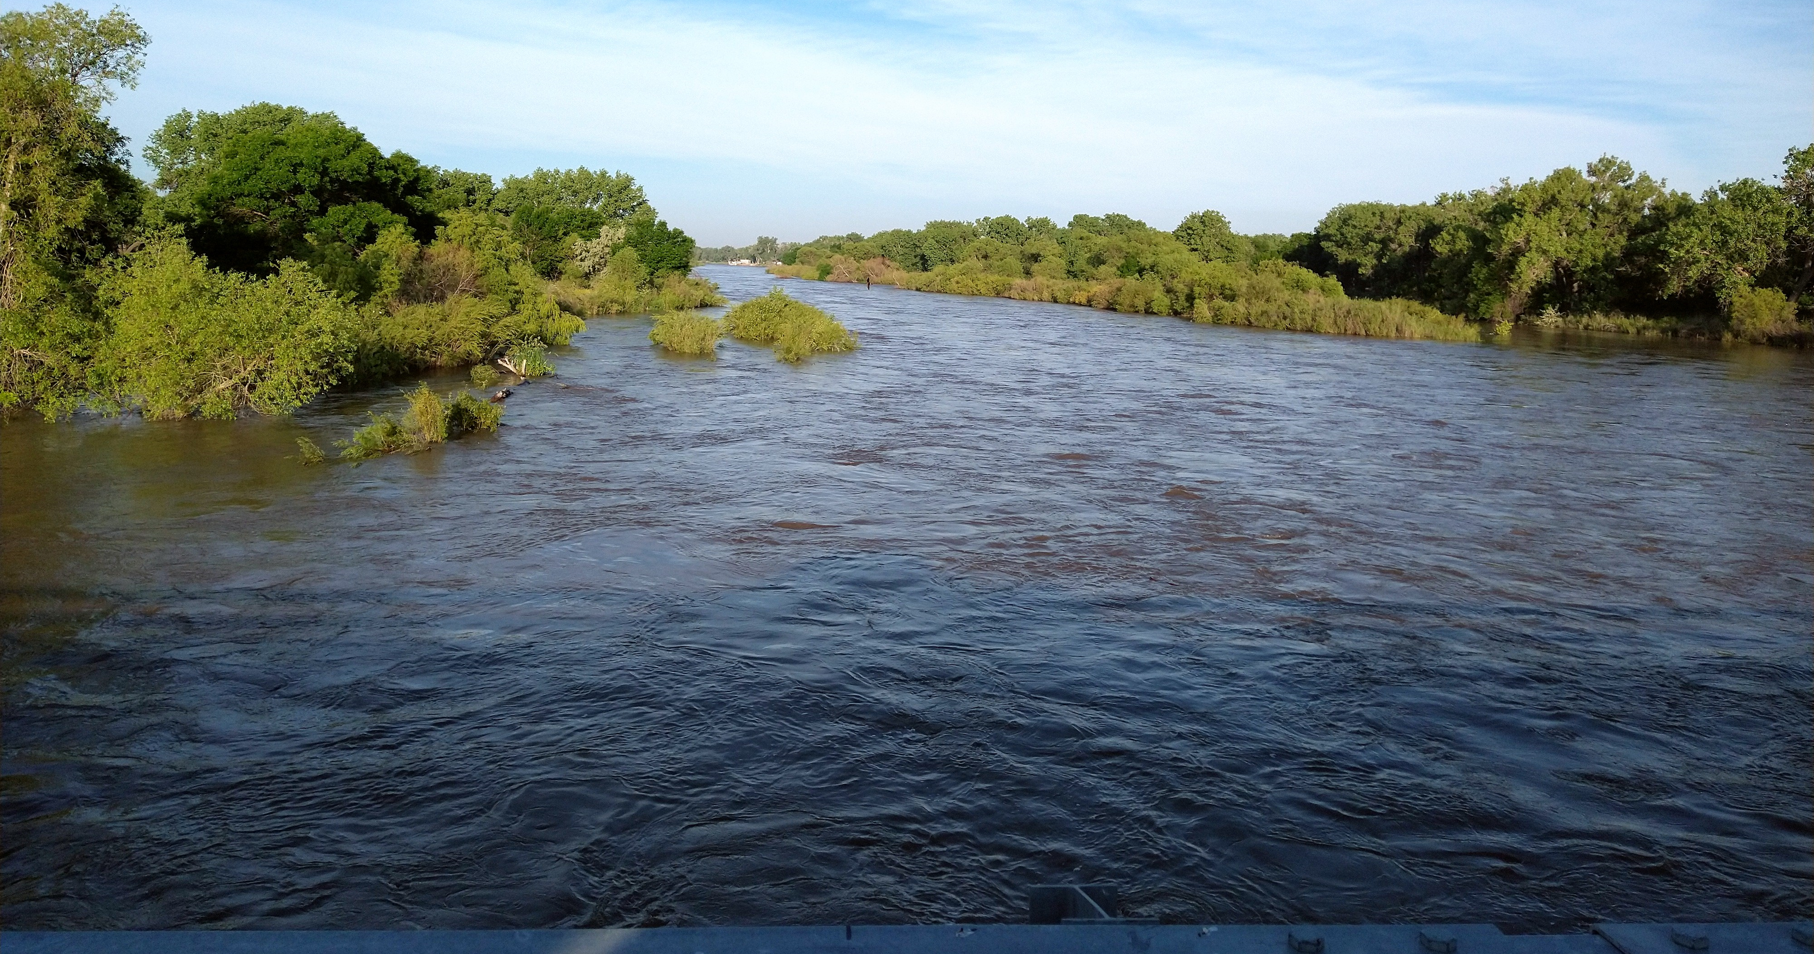
Average South Platte Flows
South Platte River Summer 2022
South Platte River Summer 2023
Notes:
Jim

Slide 23
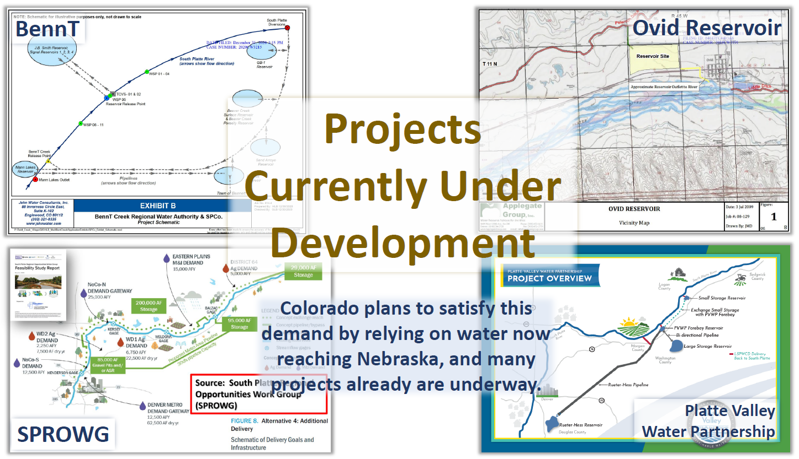
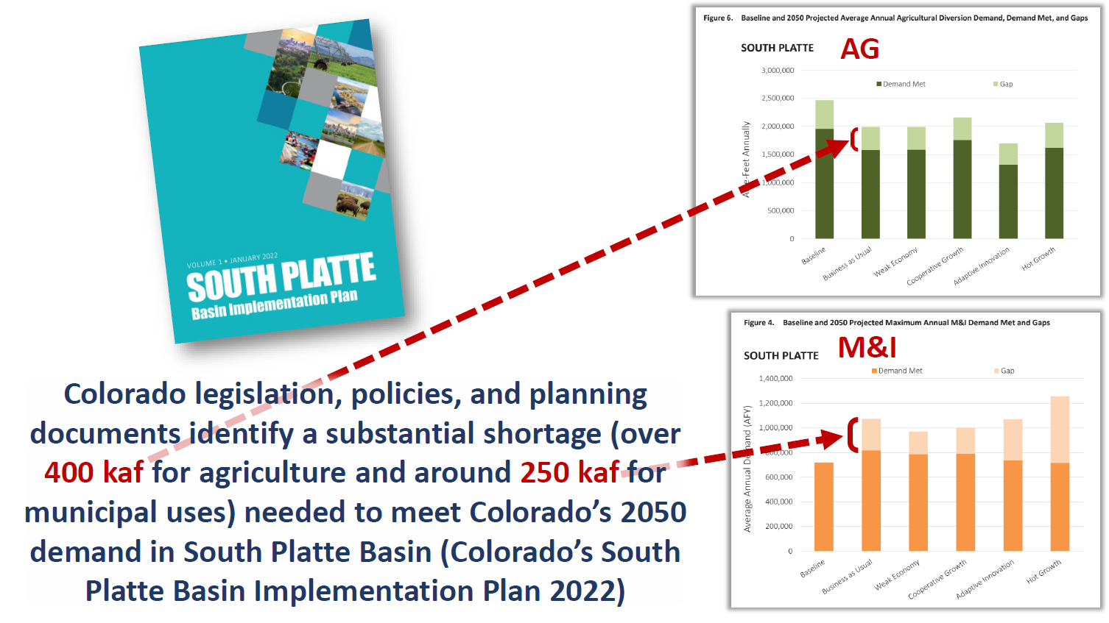
Nebraska’s Reasoning
(Nebraska’s Slides)
Notes:
Tracy
Nebraska describes that Colorado’s planned projects will reduce flow at state line

Slide 24
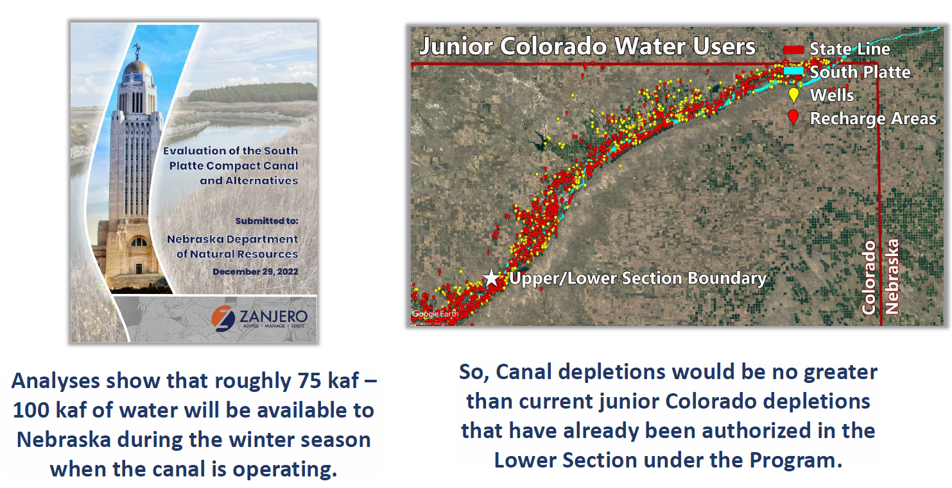
Nebraska’s Status
Completed feasibility study
Legislative funding
Designing and planning for construction
Planning for NEPA (404) and Endangered Species Act compliance
Purchased one CO property
Notes:
Tracy
Statements that construction will begin in 2026

Slide 25
Potential Impacts
Julesburg Gauge
Nebraska State Line
Julesburg Reservoir
District 64
Numerous other recharge efforts
Perkins County Canal
Heyborn Recharge
North Sterling Reservoir
Irrigation Wells
District 1
Cooper Bridge near Balzac Gauge
Tamarack Recharge
Sterling
Prewitt Reservoir
South Platte River
schematic – not to scale
Brush
Notes:
Tracy then Jim
Potential impacts in Colorado
- Junior Recharge – provides replacement water for augmentation plans upstream allowing irrigation
- Platte River Recovery – Colorado’s deliveries of recharged water for endangered species in Nebraska
- Cascading impacts… dominoes may go upstream, change reservoir releases and fills
What things are we doing – the state & lower river

Slide 26

Questions?

Slide 27
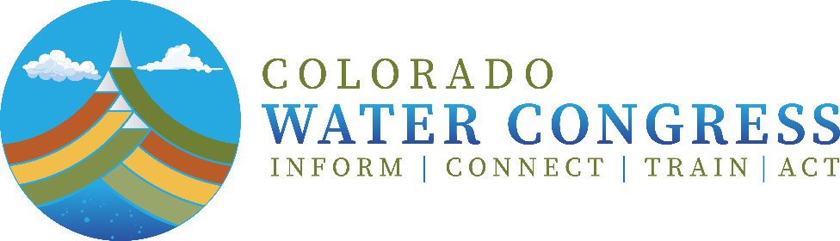
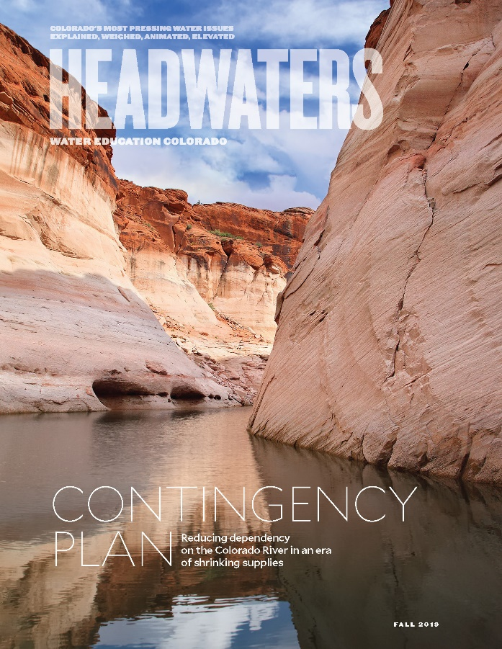
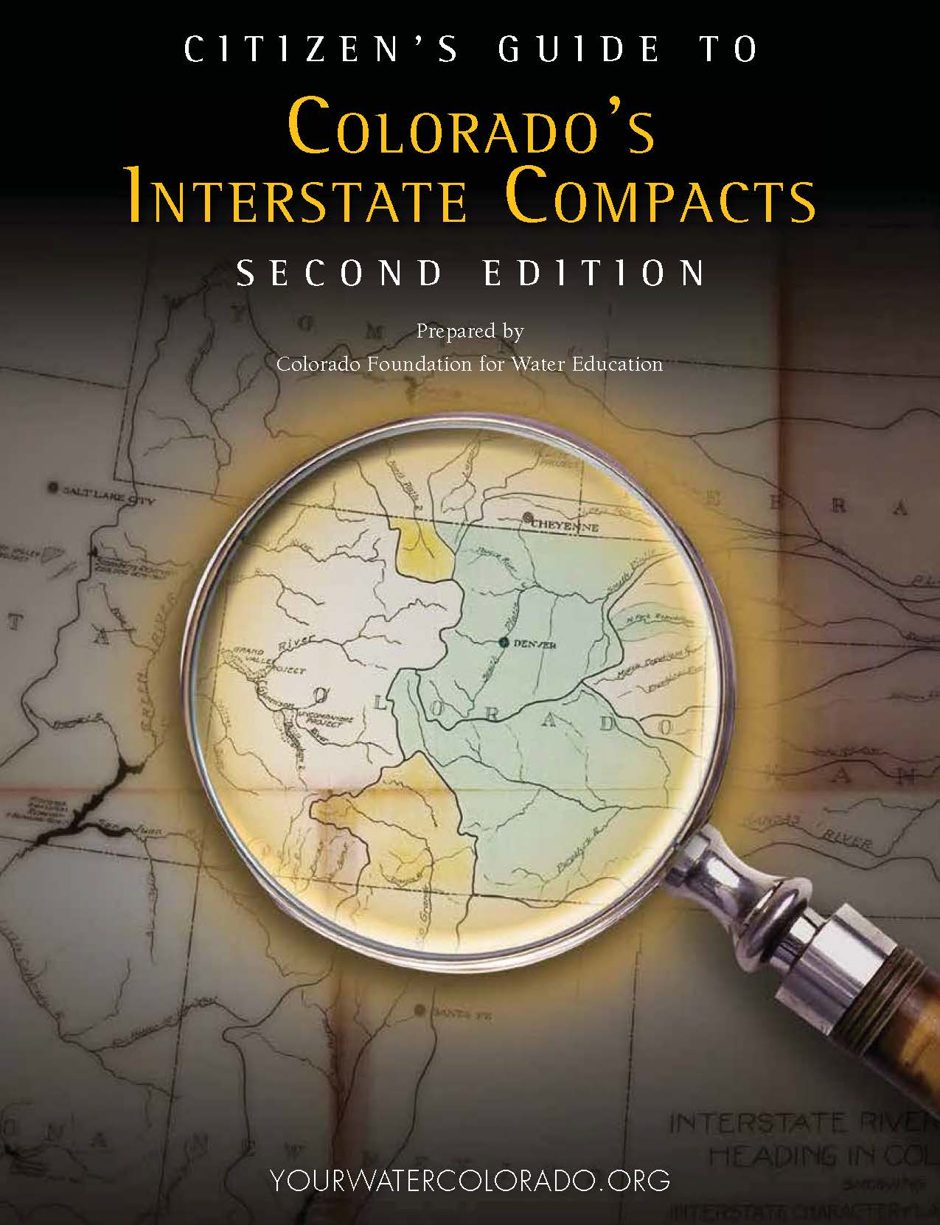
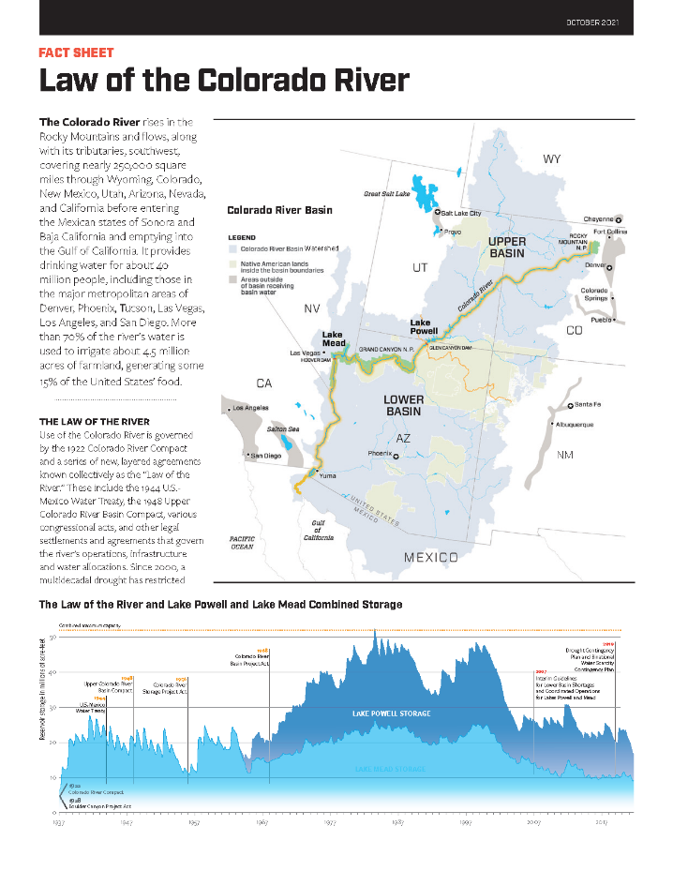
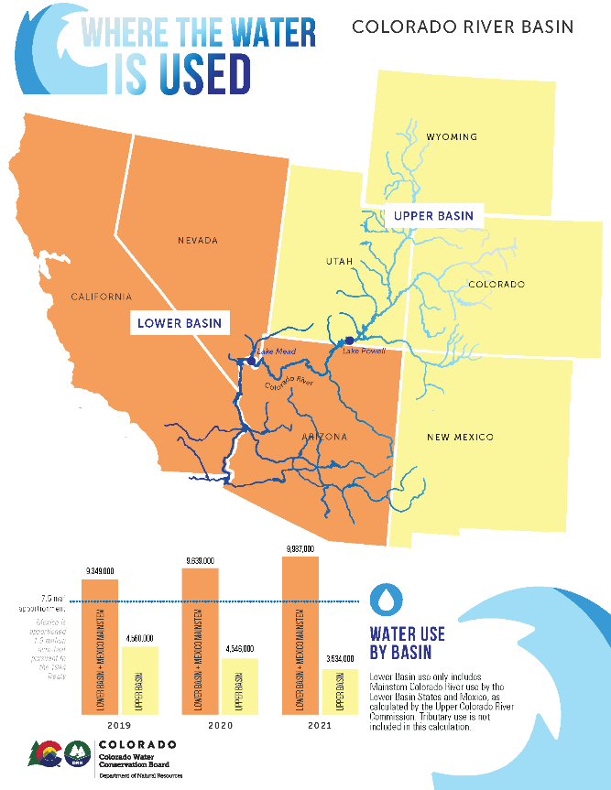
Related Resources

Slide 28
Thank you for coming!
Consider attending: June 4-5 Upper Arkansas River Basin Tour
Registration at: www.wateredco.org

